Slide 1
Online Music Classes
Tanishqa Gupta

Slide 2
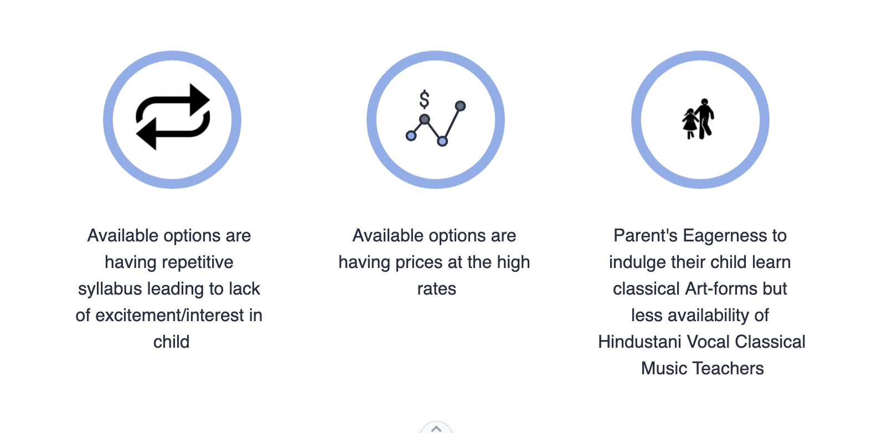
PROBLEMS

Slide 3
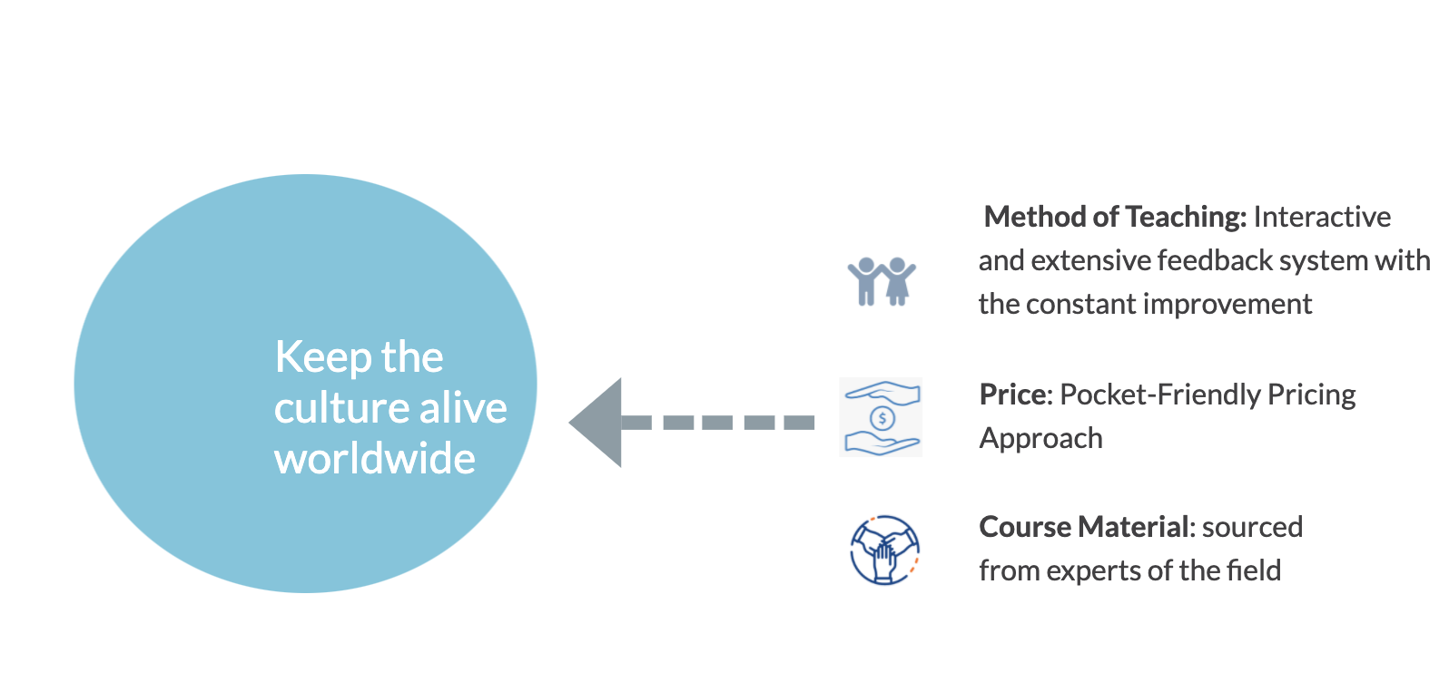
SOLUTION

Slide 4
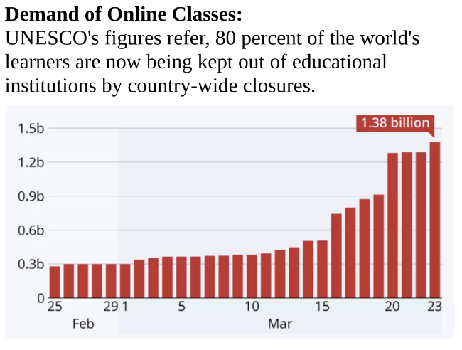
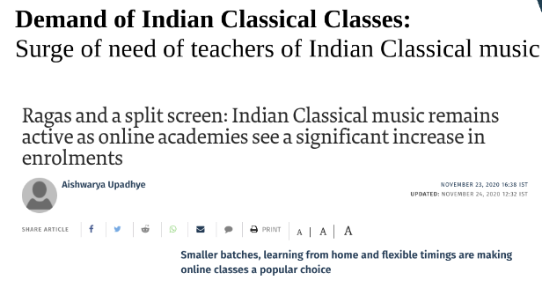
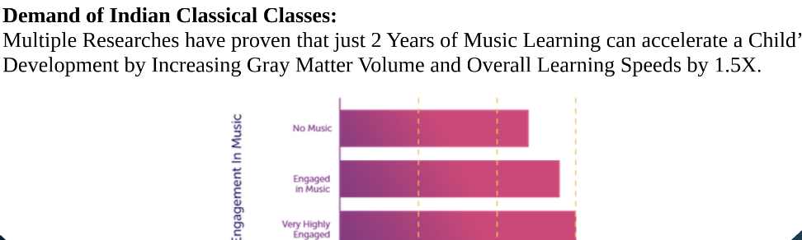
MARKETPLACE’S NEED

Slide 5
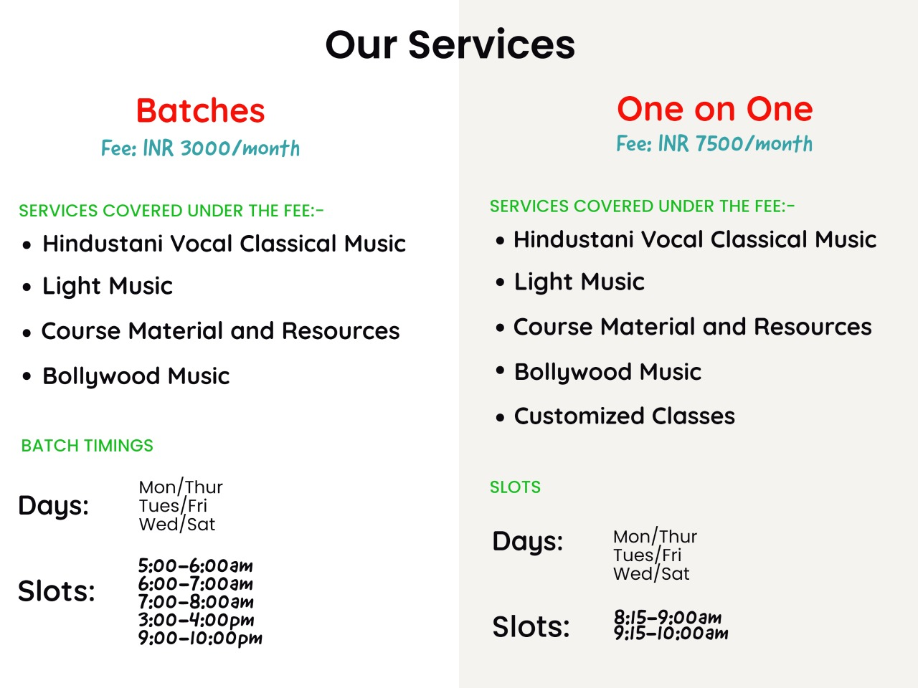
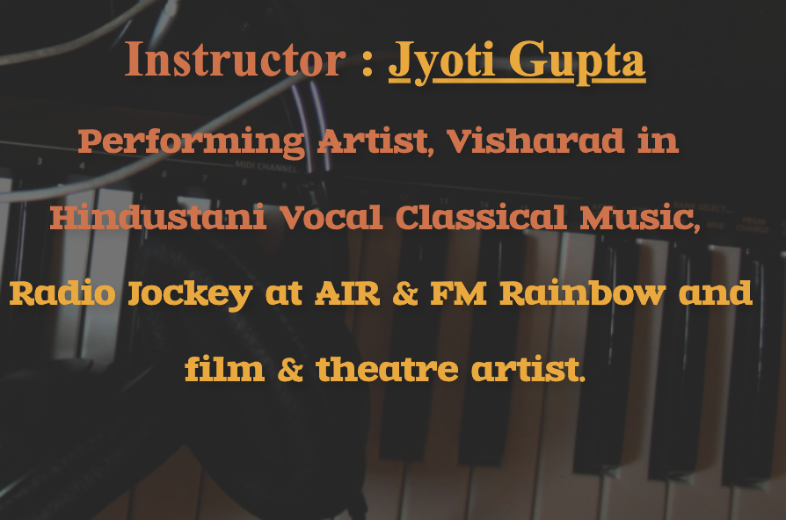
SERVICES

Slide 6
MARKET VALIDATION
Short term Goals: The target is to increase students upto 50% for existing instructor, which will double up the revenue
Long term Goals: The target is to increase number of instructor leading to increase in number of customer base
Current Revenue Growth
Maximum revenue by 10 instructors in future

Slide 7
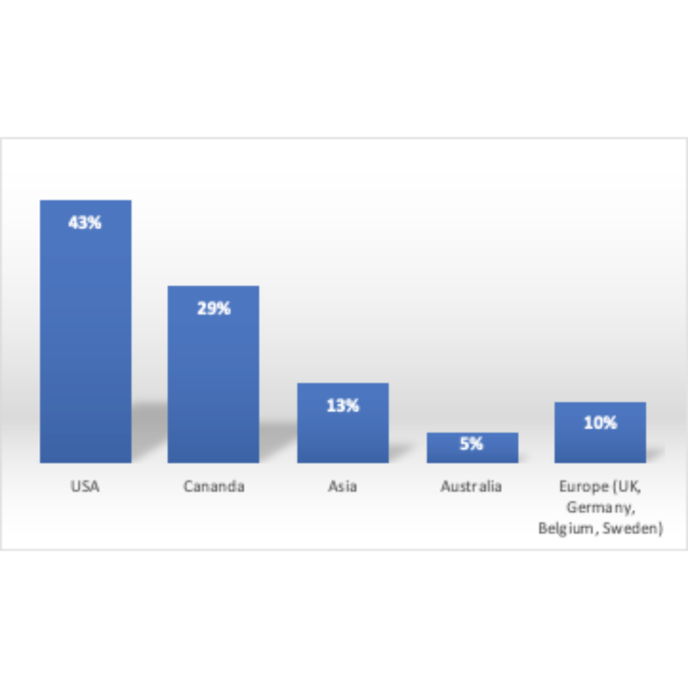
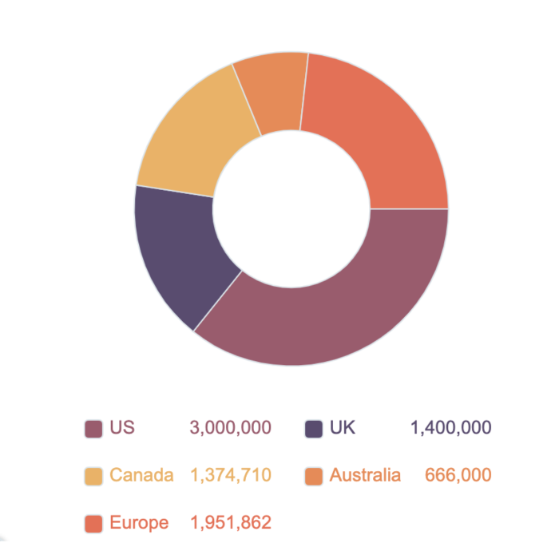
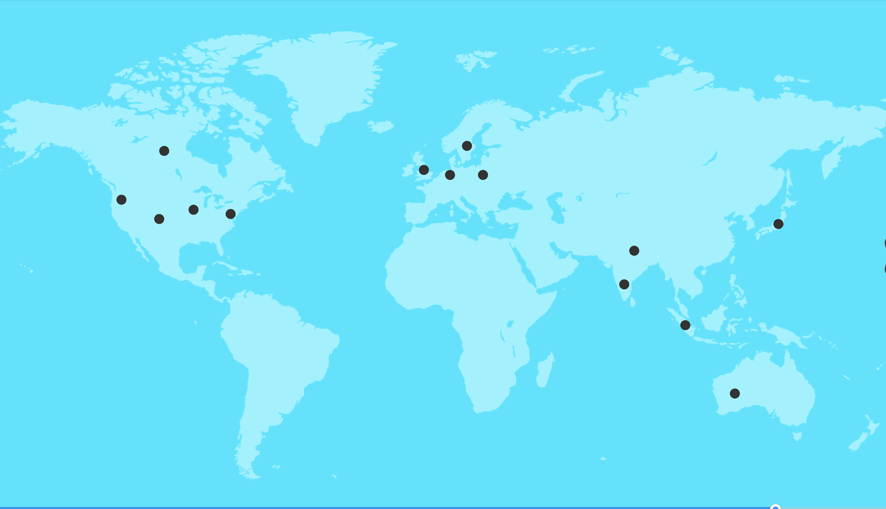
Market Size
Existing Students from various geographies
Global Presence
Our Target Audience

Slide 8
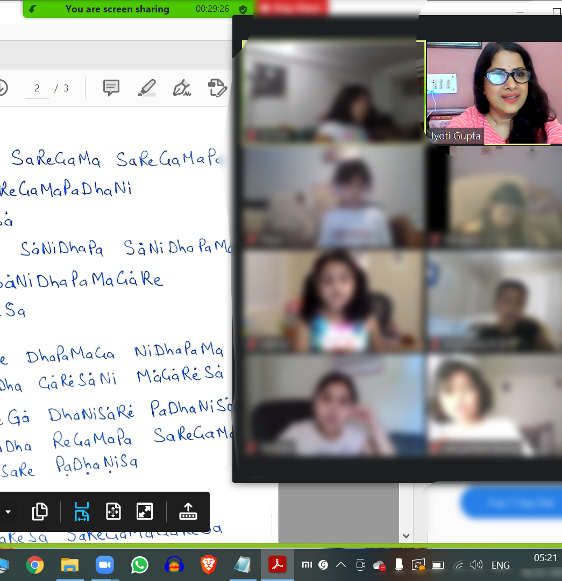
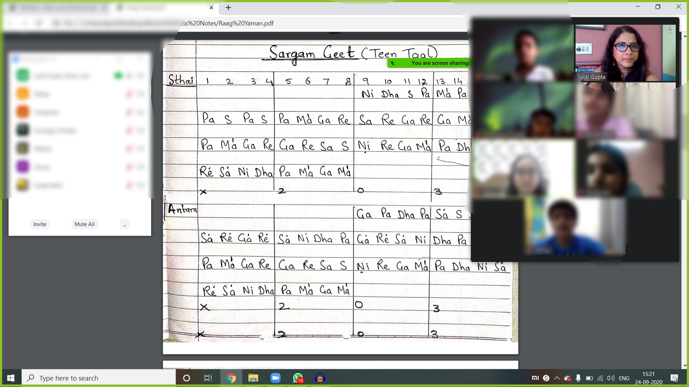
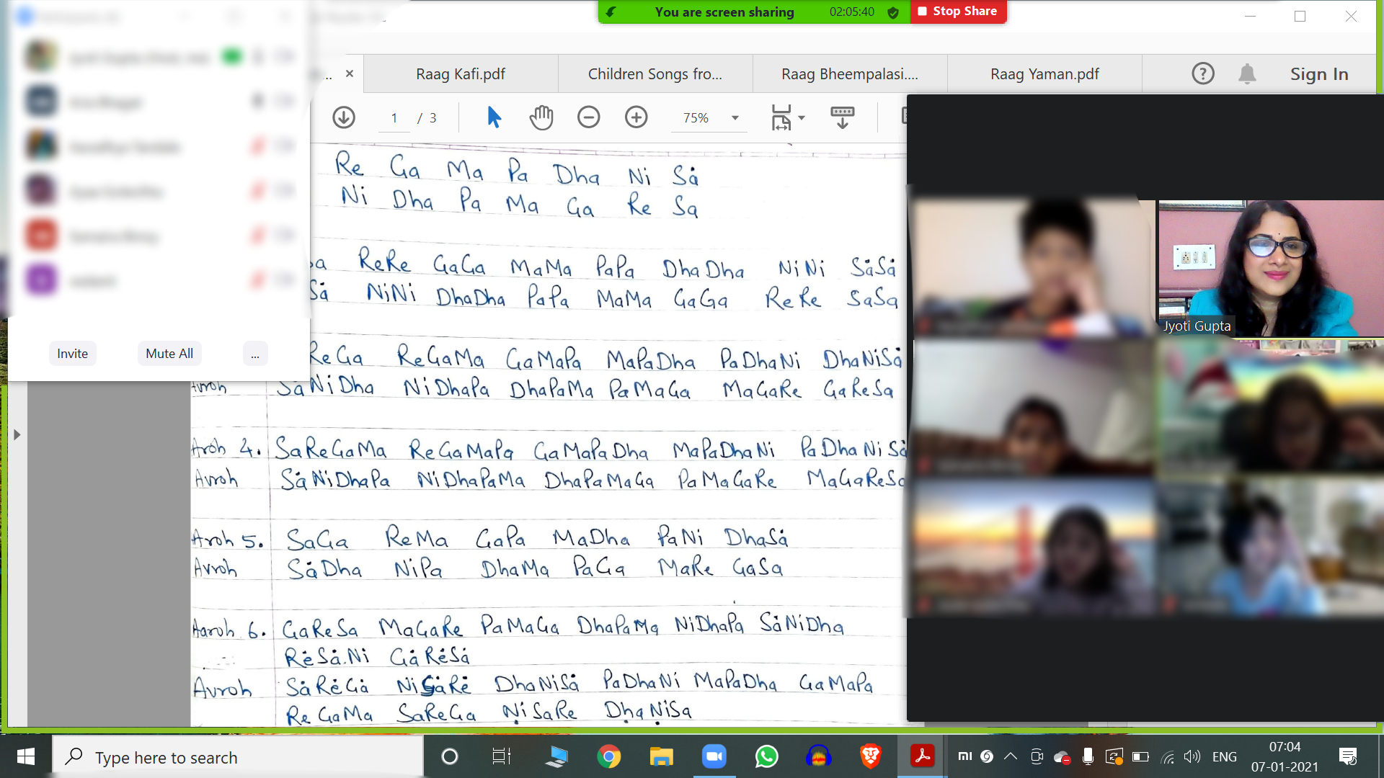
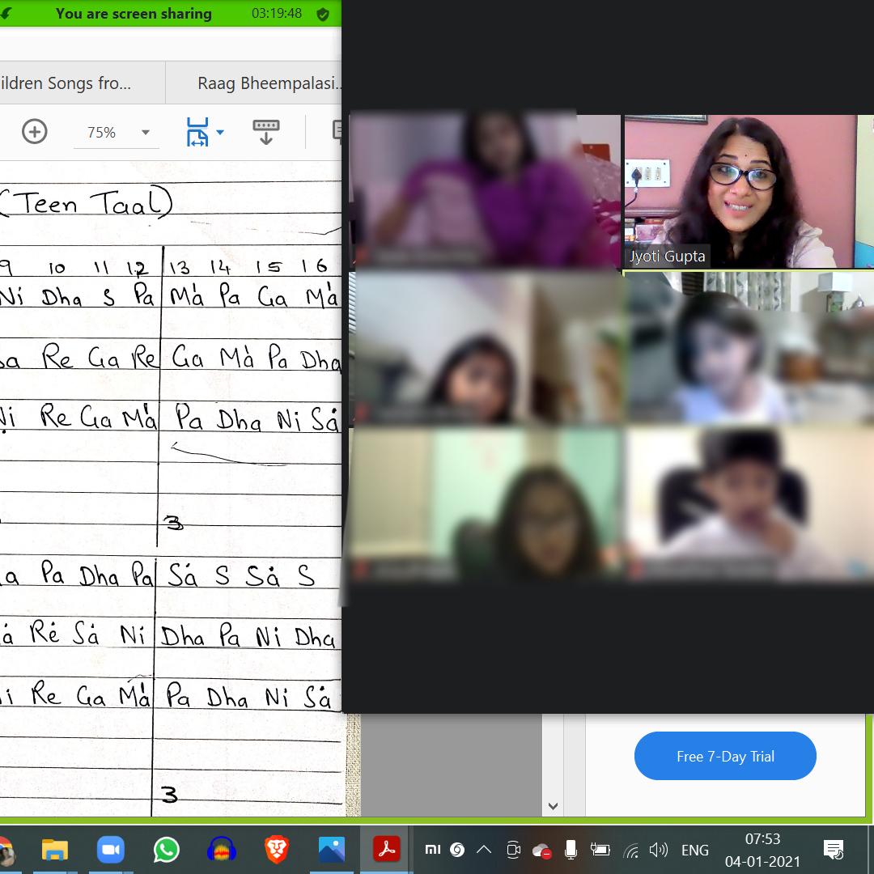

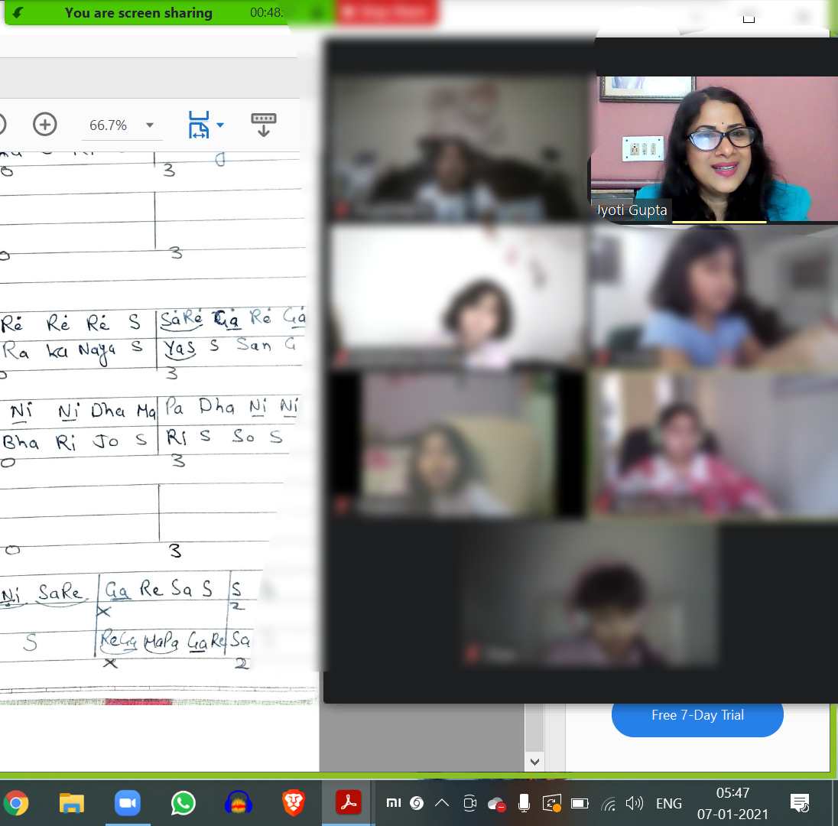
PRODUCT DEMO

Slide 9
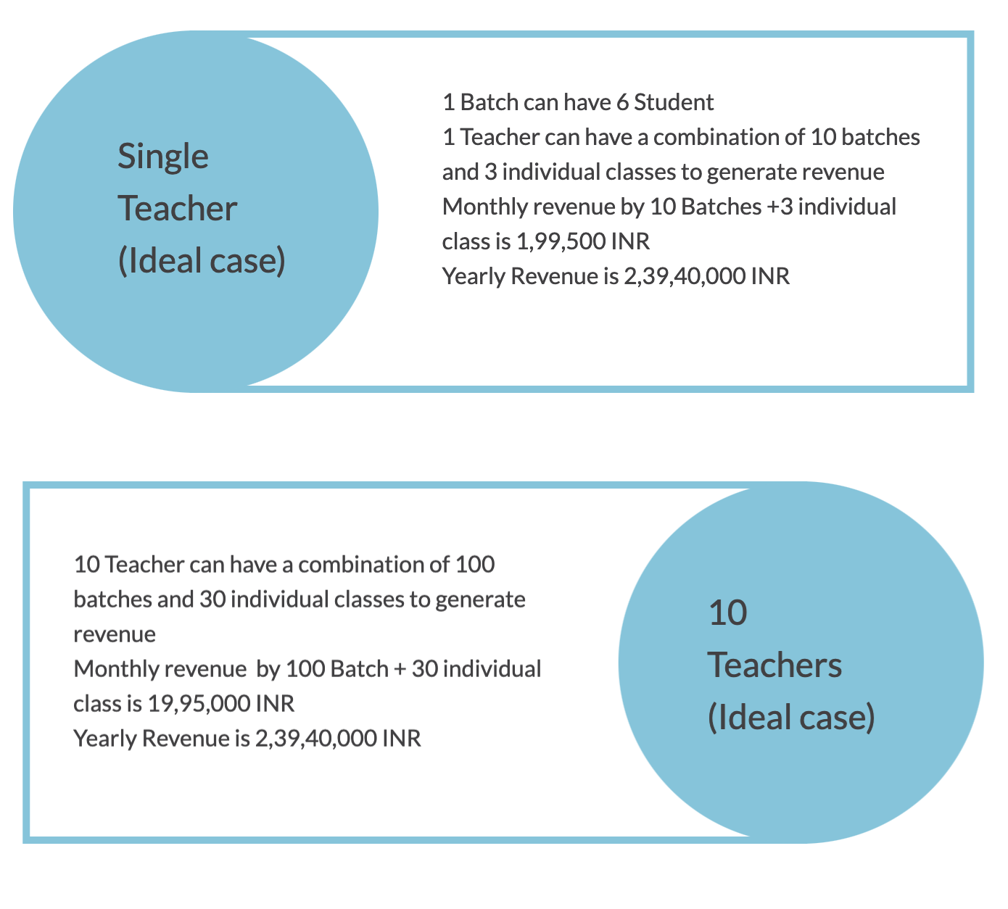

Business Model

Slide 10
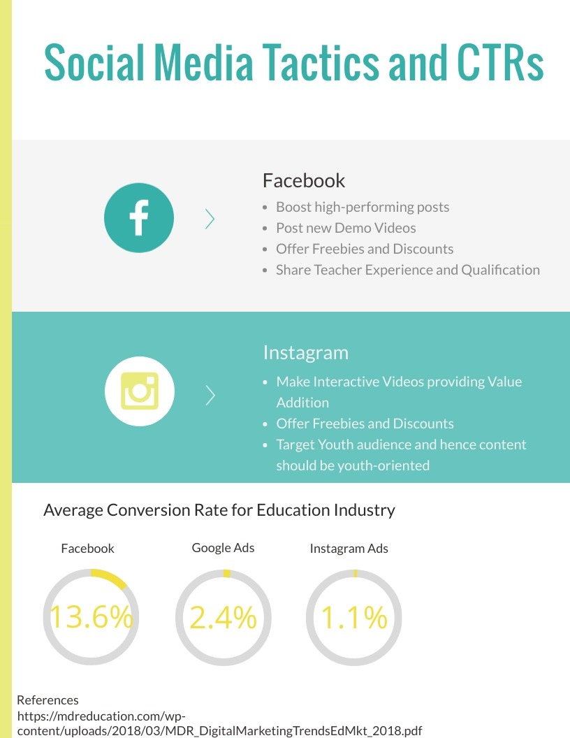
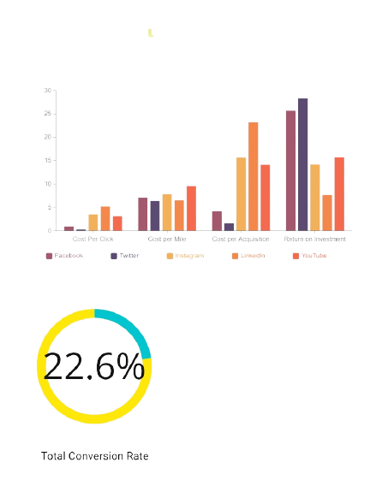
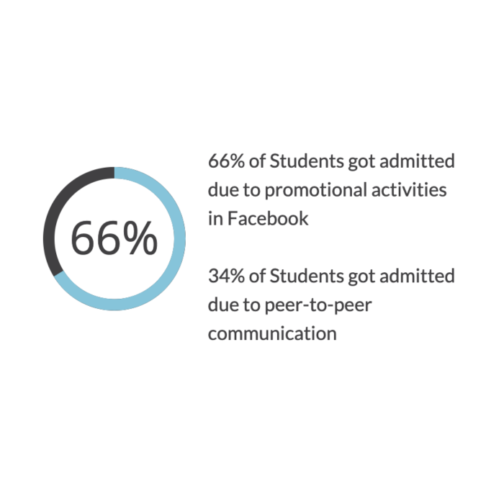

Marketing Strategy

Slide 11
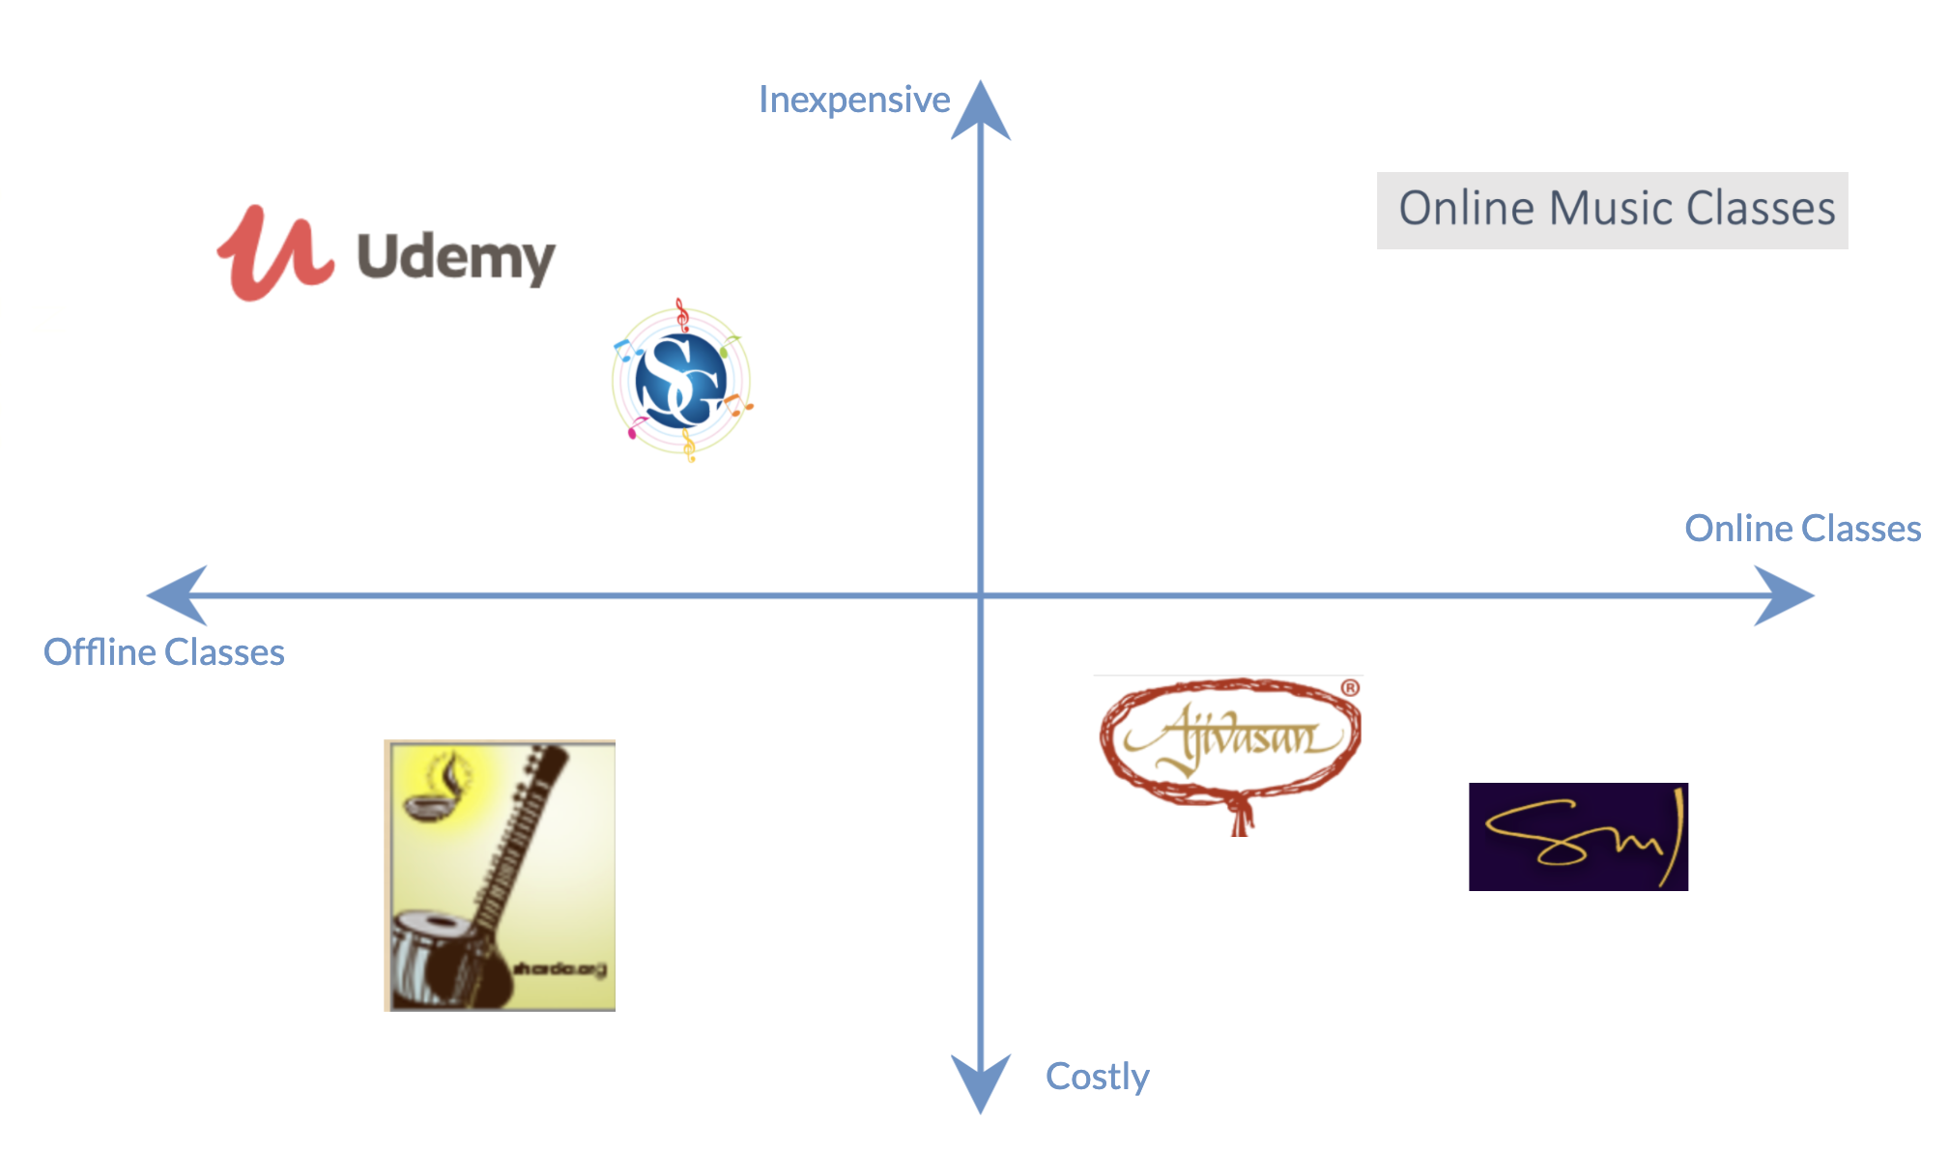
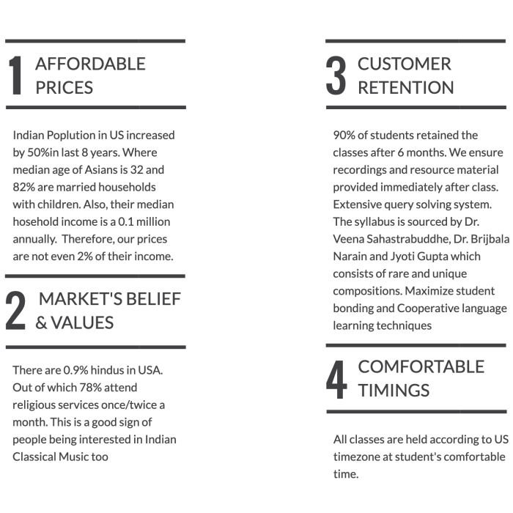
Competition and competitive advantages

Slide 12
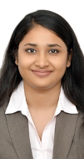
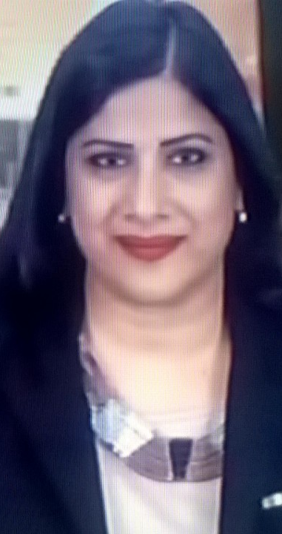
Team
Left: Tanishqa Gupta
Product Manager
Right: Jyoti Gupta
Instructor
And many more to join…

Slide 13
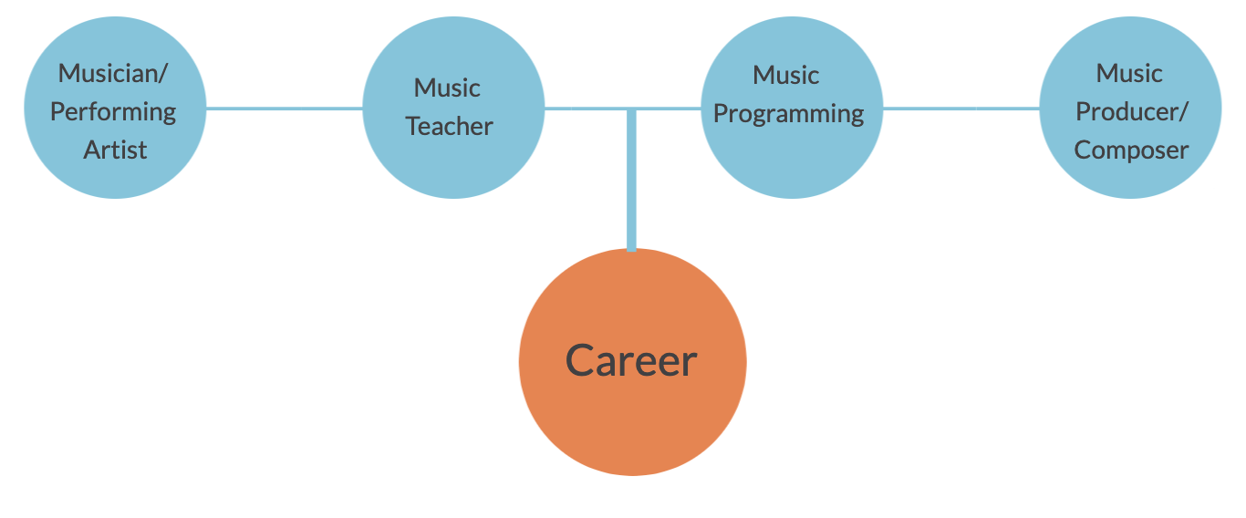
Student’s Standpoint
Tenure of the course
Certifications | Minimum time to complete the course (in years) | Number of hours spent (in years) | Monthly Pricing per Certification (in Rupees) | Half-yearly Plan (in Rupees) | Yearly Plans (in Rupees)
Prarambhik | 1 | 96 | 36000 | 34200 | 32400
Praveshika Pratham | 1 | 96 | 36000 | 34200 | 32400
Praveshika Poorna | 1 | 96 | 36000 | 34200 | 32400
Madhyama | 2 | 192 | 72000 | 68400 | 64800
Visharad | 2 | 192 | 72000 | 68400 | 64800
Alankar | 2 | 192 | 72000 | 64800 | 64800
 | 9 | 864 | 324000 | 304200 | 291600

Slide 14
Insights of KPI Dashboard

Slide 15

Keep the culture alive worldwide
Expansion of Marketing Campaigns
Onboard new Students and Teachers

